Slide 1

HOTEL MANAGEMENT SYSTEM
HOTEL MANAGEMENT SYSTEM
MINI PROJECT -1 (2020-2021)
Mentor :
Mr. Vaibhav Diwan Sir
Technical Trainer
GLAU
Presented by:
RAJAT KHANNA
(181500546)

Slide 2
ACKNOWLEDGEMENT
The project work in this report is an outcome of continuous work over a period and drew intellectual support from various sources. I would like to articulate our profound gratitude to all those people who extended their wholehearted co-operation and have helped me in completing this project successfully.
I am thankful to Mr. Vaibhav Diwan for teaching and assisting me in making the project successful.

Slide 3
INTRODUCTION
The computer has brought revolution in every sphere of human life, whether it is business, education field, governance, medical science etc. The computer has reduced the human work load, businesses are going global and everything is available at the click of mouse.
The objective of the project is to design Hotel Management application which enables the manager
to keep the record of the hotel and the customers. The project has been designed in JAVA technology
and consists of a SQL server which acts as the database for the project.
My motivation for the project came from my enthusiasm and strong urge to learn JAVA and
MySQL which is one of the fastest growing technologies in today’s world.
The Hotel Management System project mainly consists of two types of users. The
customers who access the information provided by the website and the administrator who modifies and updates the information.
All the data needed for the application is stored in the form of tables in the SQL server
2000.

Slide 4
OBJECTIVE OF THE PROJECT
The objectives of the project are as follows →
1. To develop a system for the management of hotels so that hotel owners can use this facility to
provide accurate information to the customers.
2. To develop a system that has a good management of data along with integrity and minimizing
redundancy.
3. To develop a system that will be user friendly in all possible ways.

Slide 5
HARDWARE AND SOFTWARE REQUIREMENTS
1. Hardware:
• Minimum 8GB Ram • Disk Space 80GB
2. Software:
• Netbeans IDE • MySql Database
3. Technology used :
JAVA programming language
MySQL database.

Slide 6
SCOPE FOR EXTENSION INTO A MAJOR PROJECT
Things that can be added to extend this project into a major one:
Online payment system.
2. This desktop application can be made into a website for a particular hotel
which can be used for many purposes.

Slide 7
METHODOLOGY
The modules used in this project are listed as follows:
→ Admin
→ Management
The sub-modules in the Admin module are:
: Add Employee
: Add room
: Add drivers
The sub-modules in the Management module are:
: New Customer Info : Check out
: Room : Update Check Status
: Department : Update Room Status
: All Employees Info : Pickup Service
: Customer Info : Search Room
: Manager Info : Logout

Slide 8
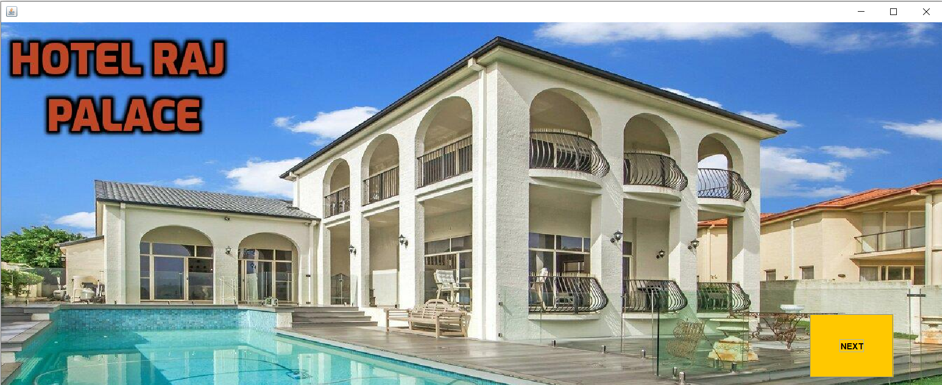
PROJECT IMPLEMENTATION
WELCOME PAGE OF THE PROJECT
To proceed, click on Next Button.

Slide 9
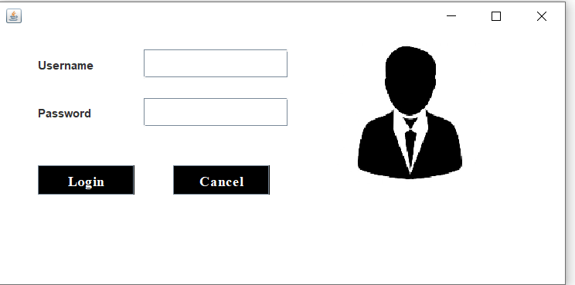
Now, login with the credentials.
If the credentials match with those
in the database, then the person is
Logged in.

Slide 10
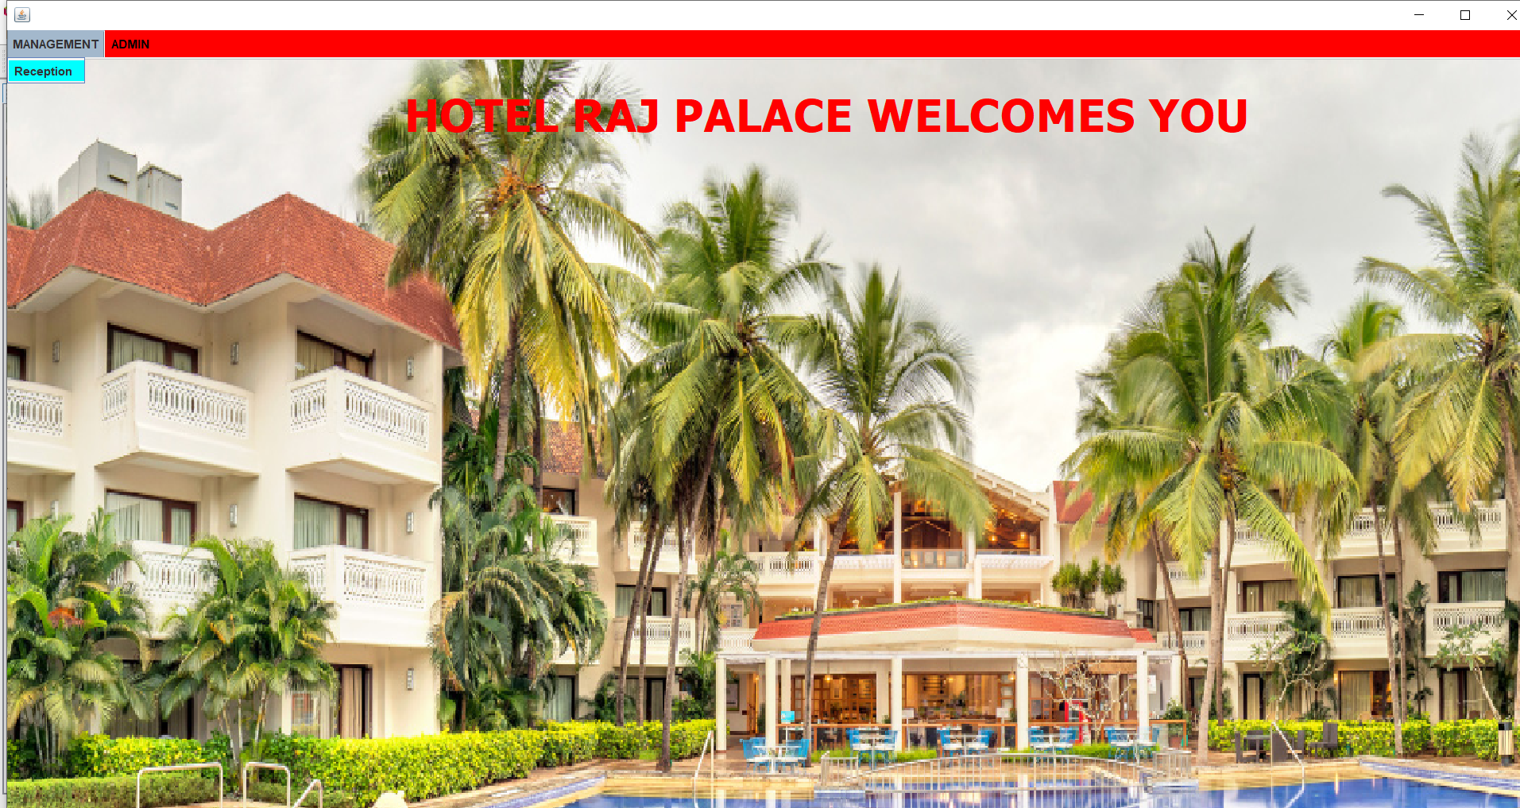
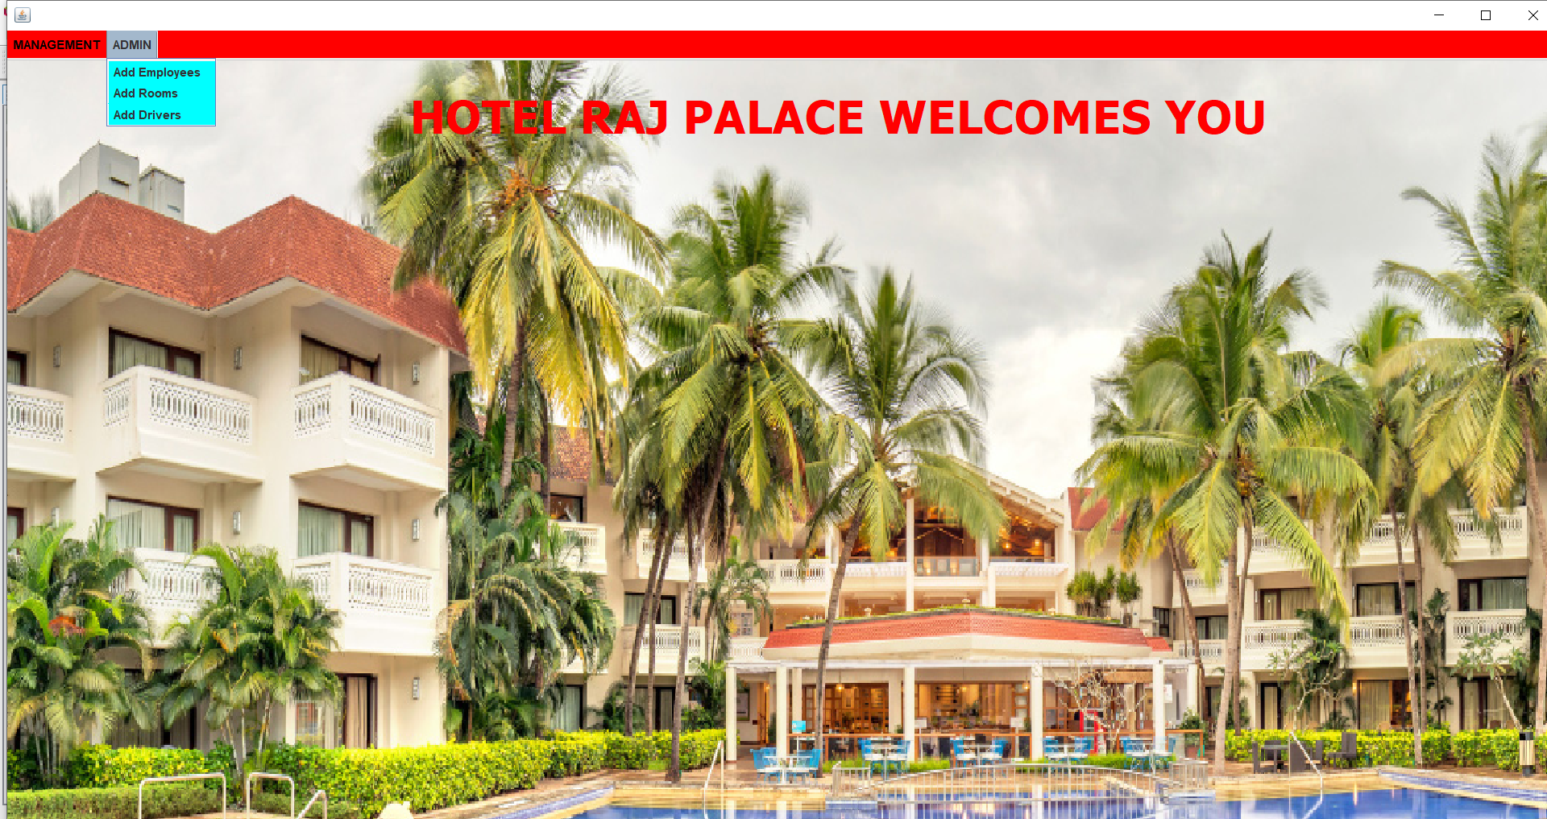
After logging in,
The frame opens .
This frame has a menu bar consisting of
Two options : Management and Admin.
MANAGEMENT
ADMIN
RECEPTION
ADD EMPLOYEES
ADD ROOMS
ADD DRIVERS

Slide 11
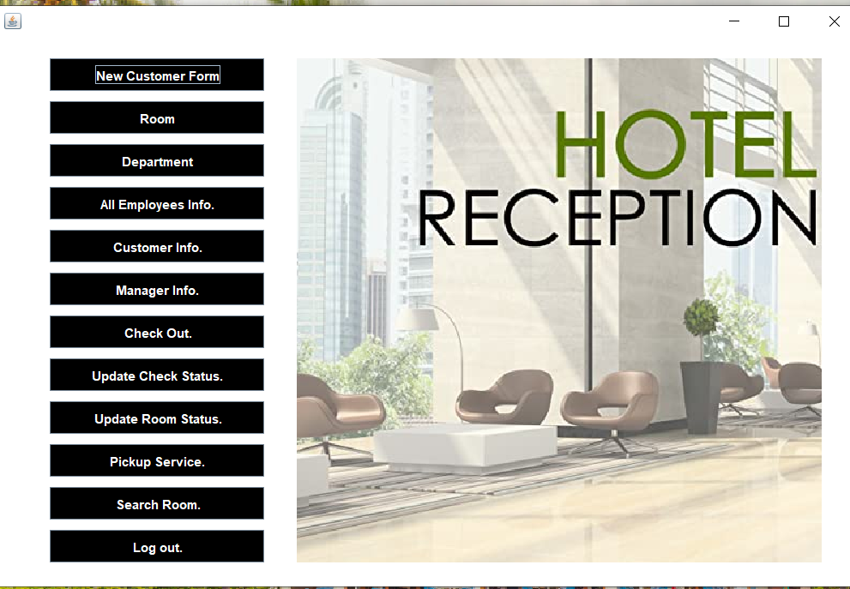
On clicking Reception button, this frame opens .
This frame consists of all the operations that a receptionist of the hotel can do.

Slide 12
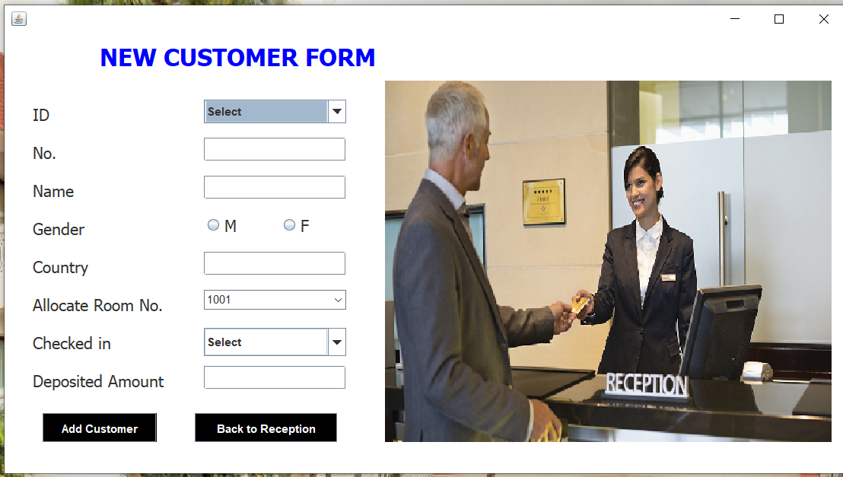
RECEPTION MENU
NEW CUSTOMER FORM
This is the frame for adding new customer.

Slide 13
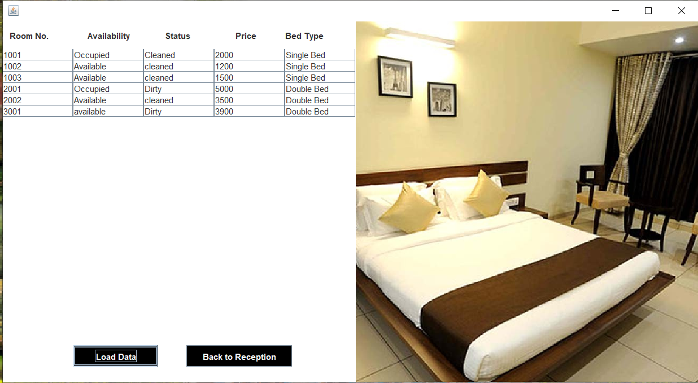
ROOM
This is the frame for
seeing the details of the room.

Slide 14
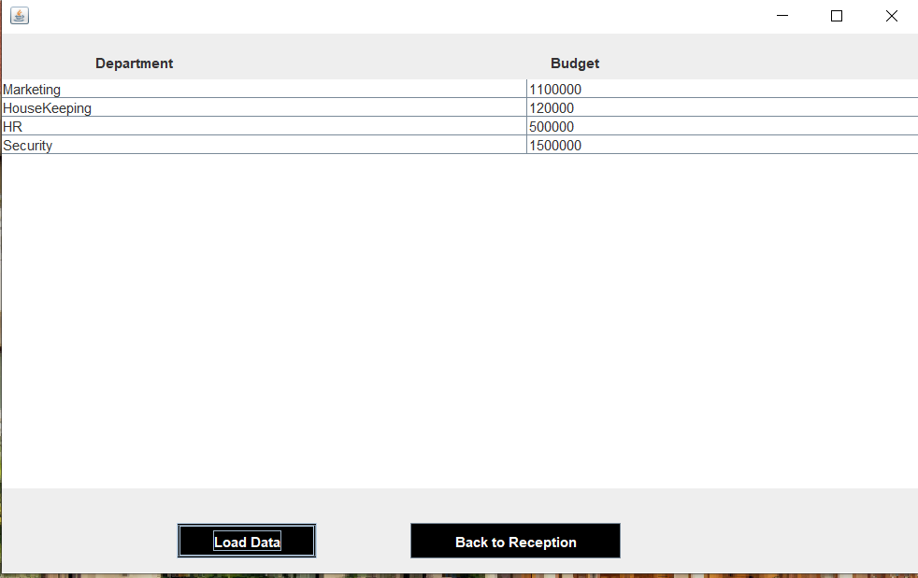
DEPARTMENT
This is the frame for
Seeing the funding details .

Slide 15
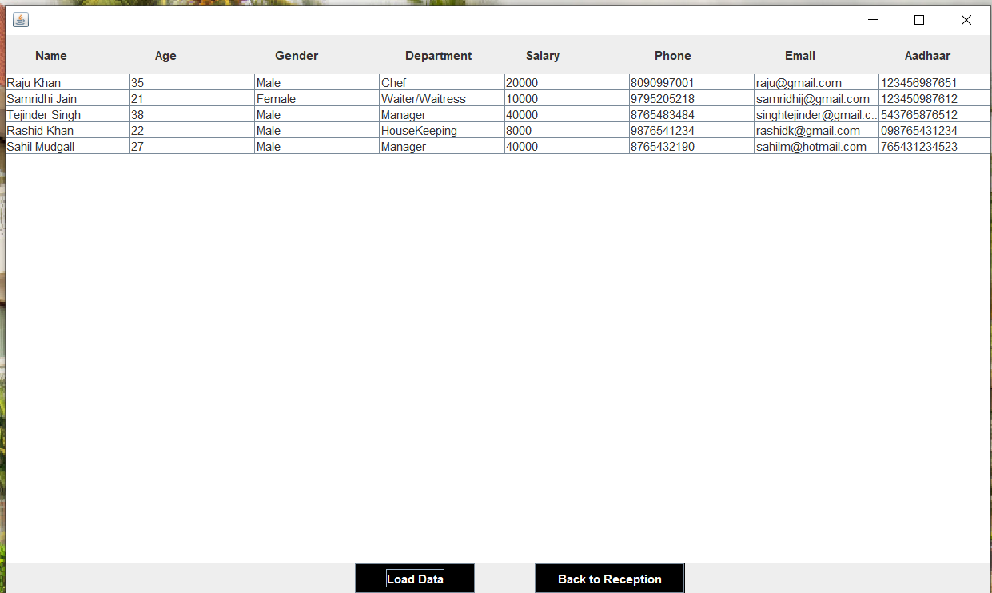
ALL EMPLOYEES INFO.
This is the frame for
Seeing the details of all the
Employees working in the hotel.

Slide 16
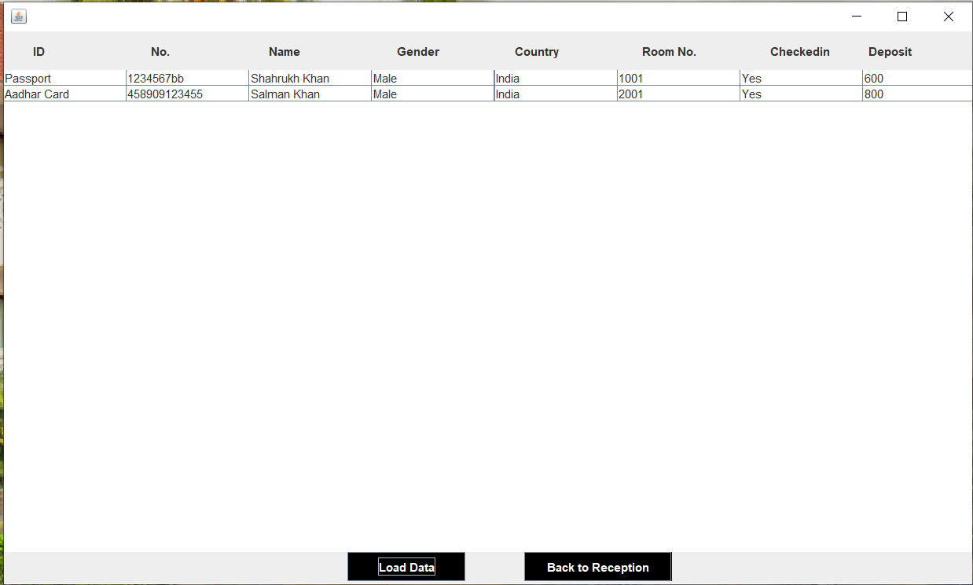
CUSTOMER INFO.
This is the frame for
Seeing the details of all the customers
Staying in the hotel.

Slide 17
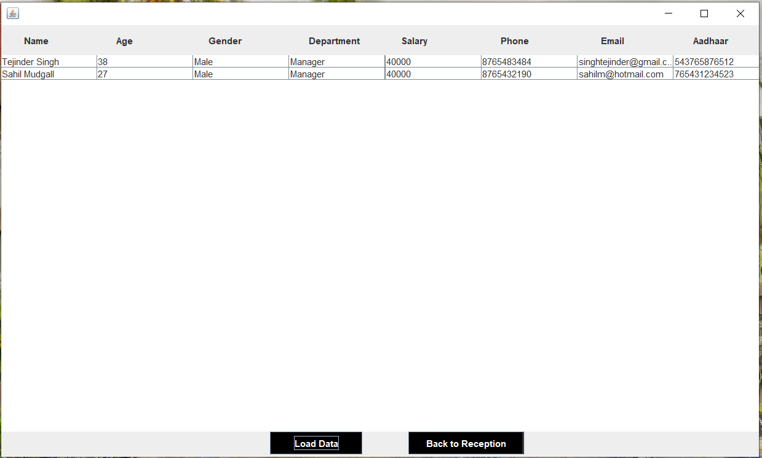
MANAGER INFO.
This is the frame for
Seeing the details of the Manager
Of the hotels.

Slide 18
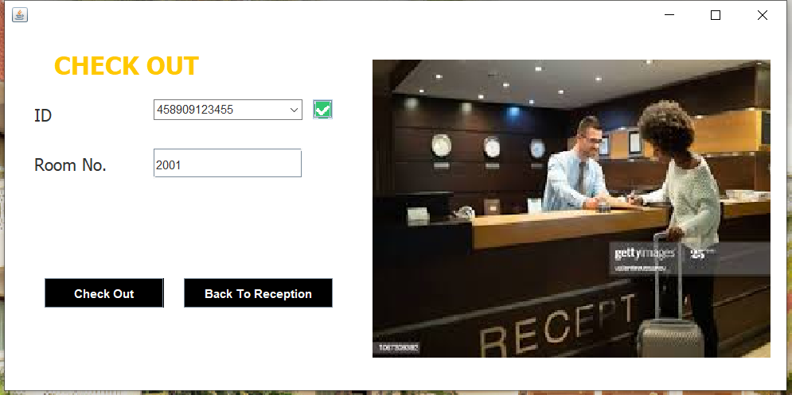
CHECK OUT
When the customer wants to check out,
This frame opens .

Slide 19
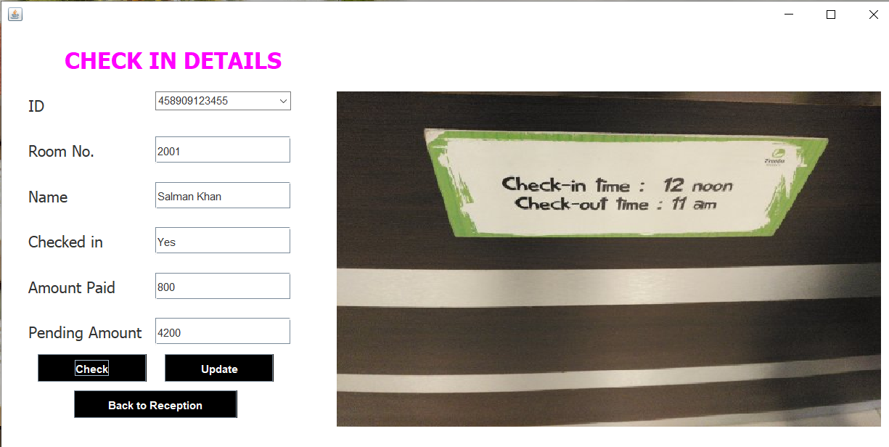
UPDATE CHECK STATUS
This is the frame for
Updating the customer details when he/she
Checks in the hotel.

Slide 20
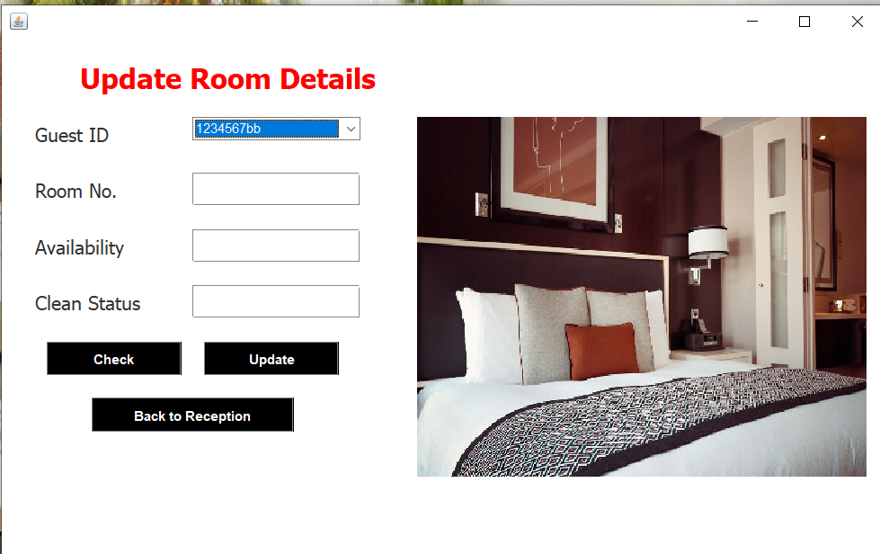
UPDATE ROOM STATUS
When the customer checks out from
Hotel, then room details should be
Updated.
This frame is used .
Availability – Occupied to Available
Status – Dirty to Clean.

Slide 21
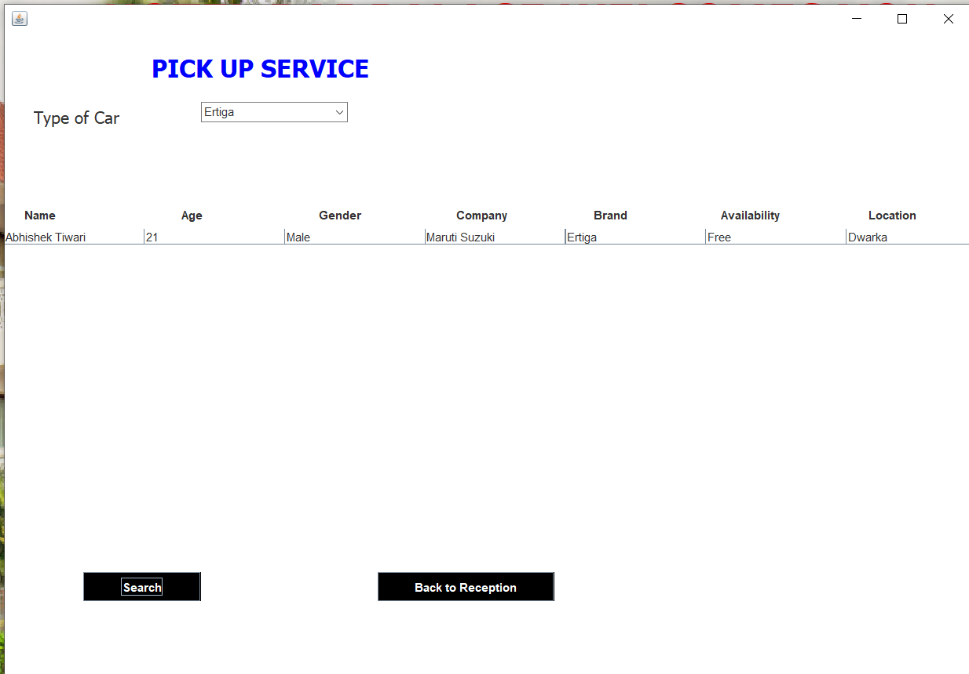
PICKUP SERVICE
Suppose the customer wants to go from hotel to any place or customer wants a cab to come to hotel from any place , so this frame can be used to book a cab(according to the location).

Slide 22
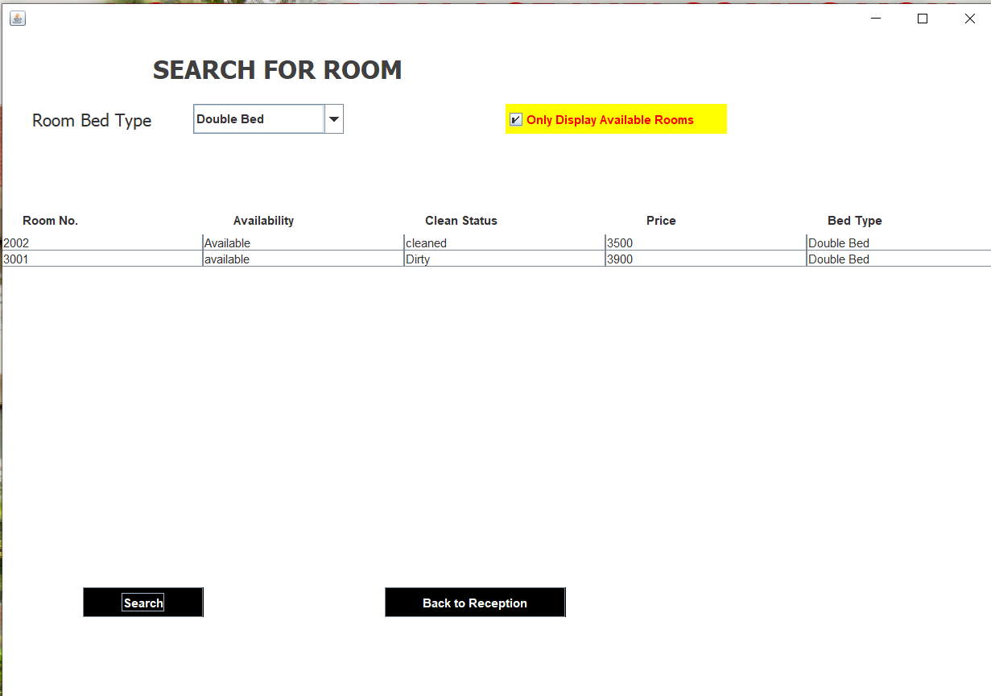
SEARCH ROOM
If a new customer comes to the hotel,
Then this can be used to see which room
Is available at the moment.

Slide 23
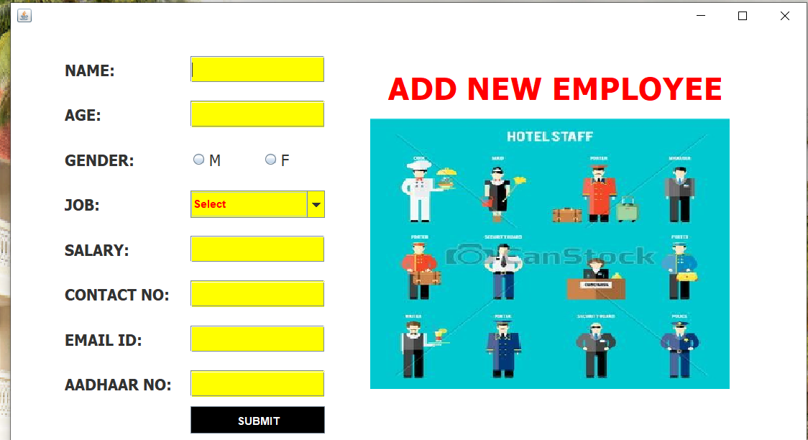
ADMIN MENU
ADD EMPLOYEES
This is the frame for adding new employees .

Slide 24
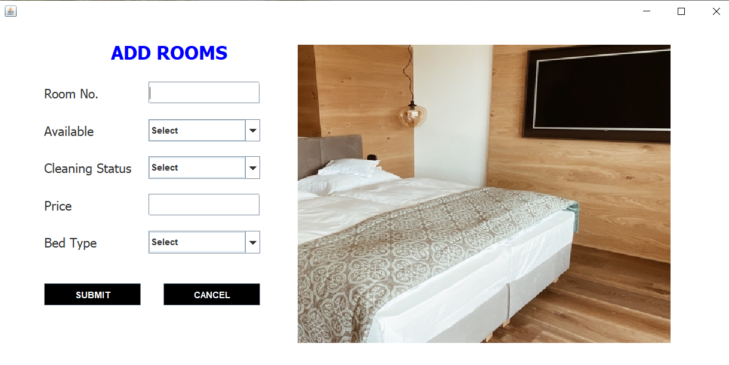
ADD ROOMS
This is the frame for adding new rooms.

Slide 25
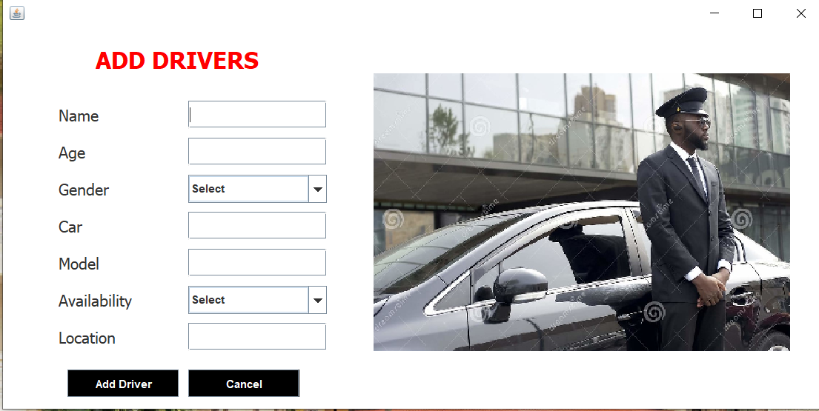
ADD DRIVERS
This is the frame for adding new drivers.

Slide 26
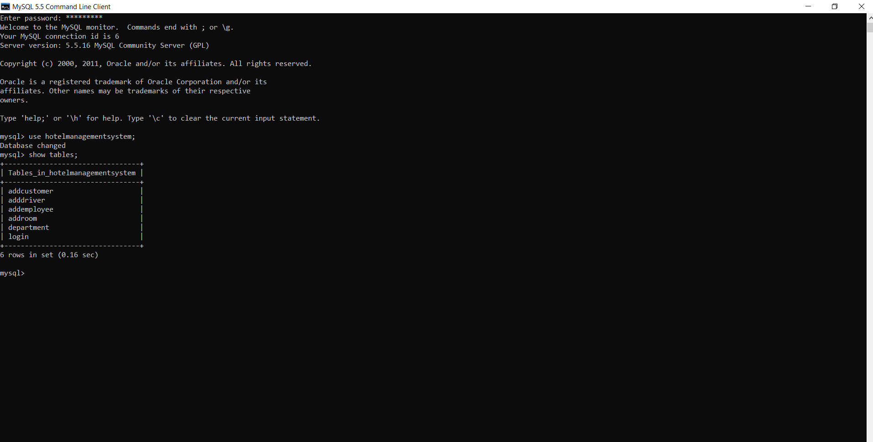
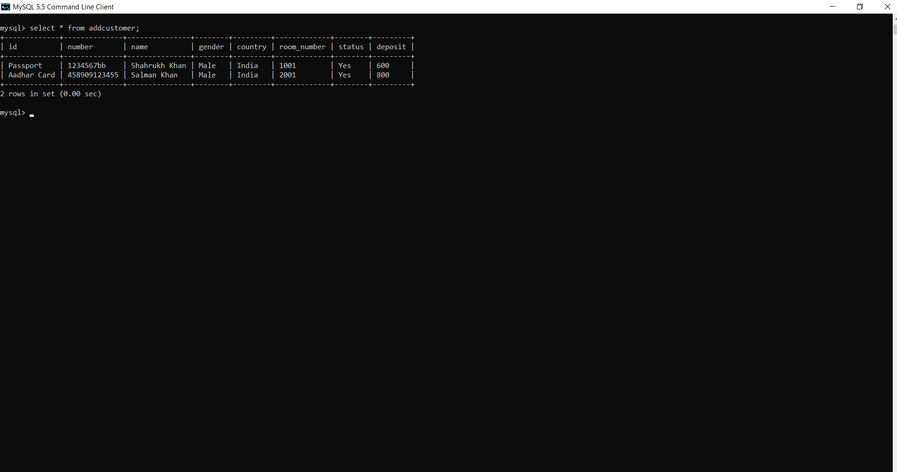
DATABASE IMPLEMENTATION SCREENSHOTS

Slide 27
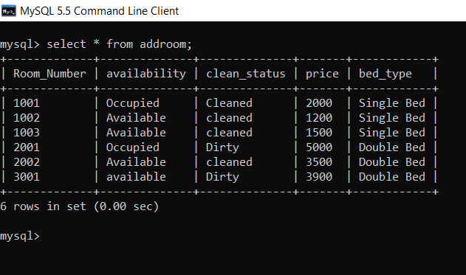
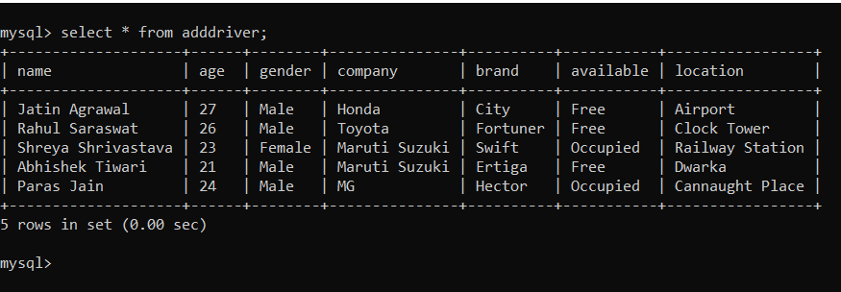
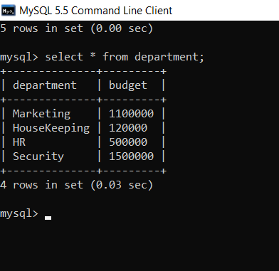
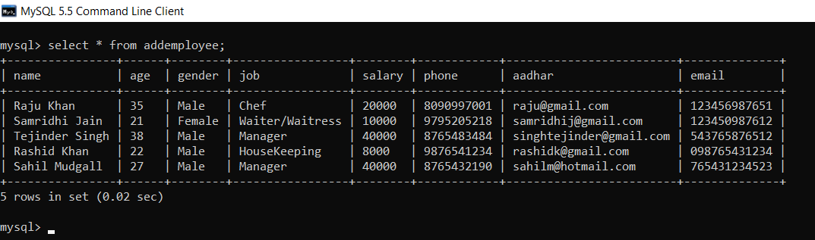

Slide 28
CONCLUSION
Hotel Management System will help the owner or manager of the hotel to maintain the information of employees and customers and give accurate service to the customers.

Slide 29


